Slide 1
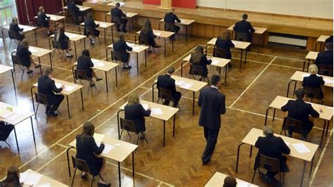
241 days
32 weeks
140 school days
230 days
28 weeks
133 school days
Identify 90 one-hour slots of revision.
Cross out 30
And fully commit to 60 focussed hours of revision.
One hour of form time is assigned for revision!

Slide 2
Revision timetables-getting started
Subjects to revise for:
Maths
English
Science
Geography
History
Music
Business Studies
Rank order (most revision needed)
1st. Science
2nd. Maths
3rd. Geography
4th. English
5th. Business Studies
6th. Music
7th. History
List all the subjects that you need to do revision for.
Now rank them in order, with the first being the subject in which you need to do the most revision.
Look at your last report (year 10PC3). Think about your target grades and current attainment to work this out. Discuss with teachers if you need to.

Slide 3
Revision timetables-Creating the timetable
Colour-code subjects so that your timetable is easy to read and you can glance at it quickly and know what you’re doing.
Make sure you put sessions in that allow you to relax and unwind. Try to find time to see friends and family and do the things that you enjoy.
Be realistic! For example: Don’t plan to revise maths for 12 hours solid on a Saturday, because it won’t happen and you won’t benefit from it. Break the day up into manageable pieces and do spend hours trying to do the same thing – it won’t help you.
Have your revision timetable somewhere where you will see it everyday, so it acts as a reminder of what you need to do.
Put a copy on your phone or set alarms/reminders that will help you stick to your plan.

Slide 4
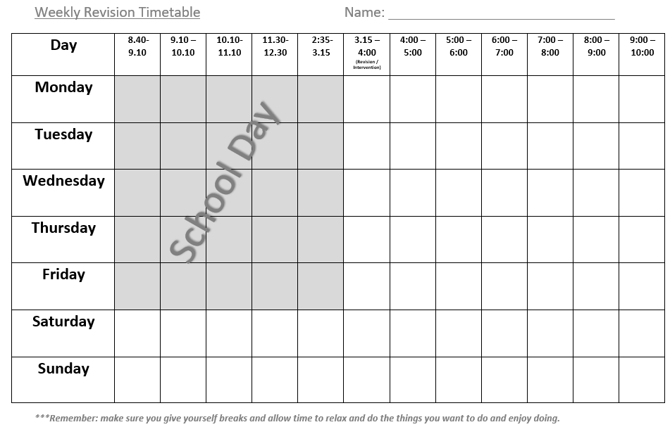

Slide 5
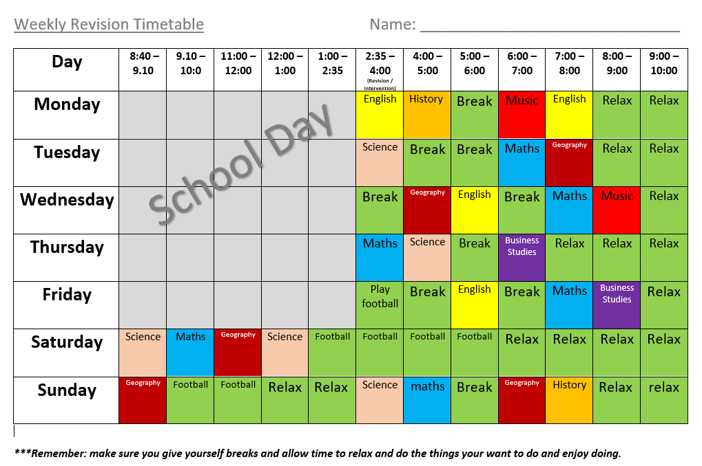

Slide 7


