Slide 1
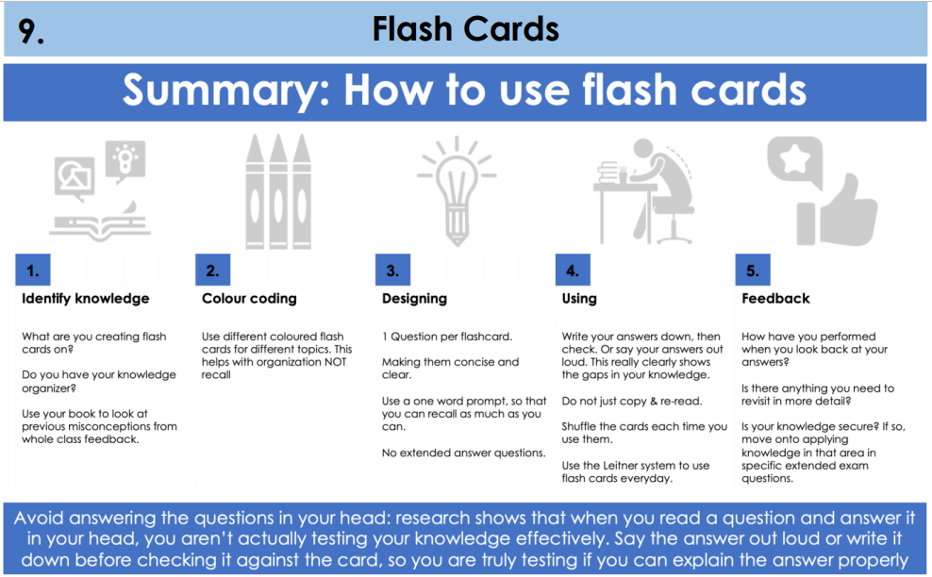

Slide 2
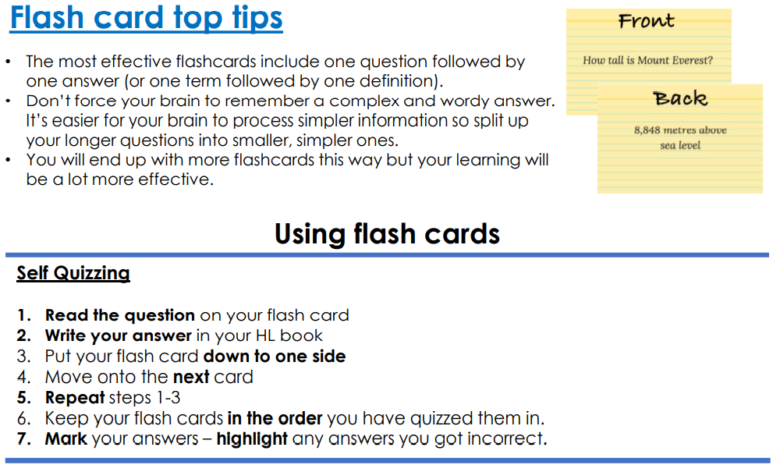

Slide 3
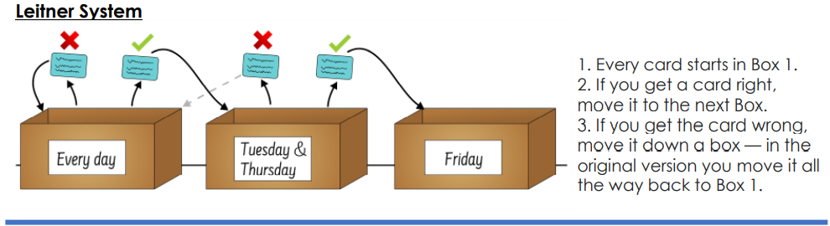

Slide 4
Flash cards in geography
We are currently studying a ‘Rivers’ topic so you could use the following questions on the front of your cards. Then you could put the answers on the back!
Your tutors will be able to give examples from their own subjects ☺
What are the 4 types of erosion that occur in the river?
What are the 4 types of transportation that occur in the river?
What landforms can be found in the upper course?
What landforms can be found in the middle course?
What landforms can be found in the lower course?
How does an ox bow lake form?
How does a waterfall form?
Name 2 natural and 2 human causes of flooding.

Slide 5
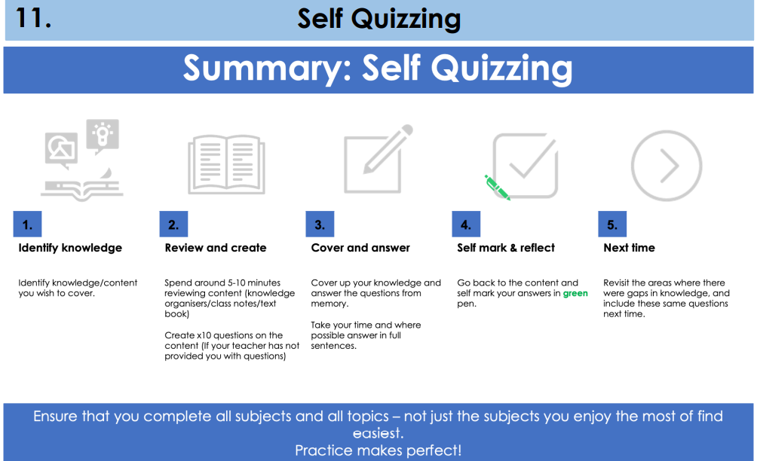

Slide 6
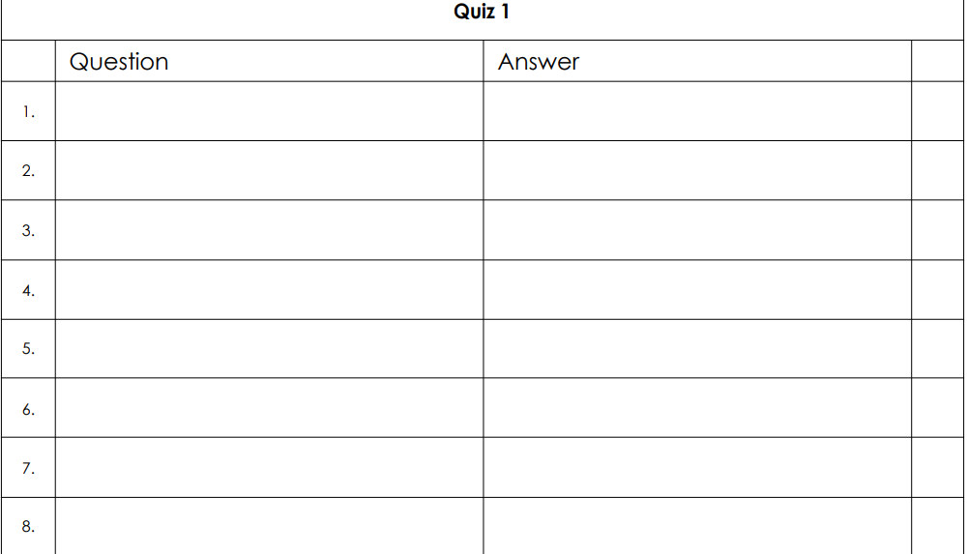
What are the 4 types of erosion that occur in the river?
What are the 4 types of transportation that occur in the river?
What landforms can be found in the upper course?
What landforms can be found in the middle course?
These are the same questions as before. You can revise the same content but use different techniques to see which one suits you best!
What landforms can be found in the lower course?
How does an ox bow lake form?
How does a waterfall form?
Name 2 natural and 2 human causes of flooding.

Slide 7


Slide 8
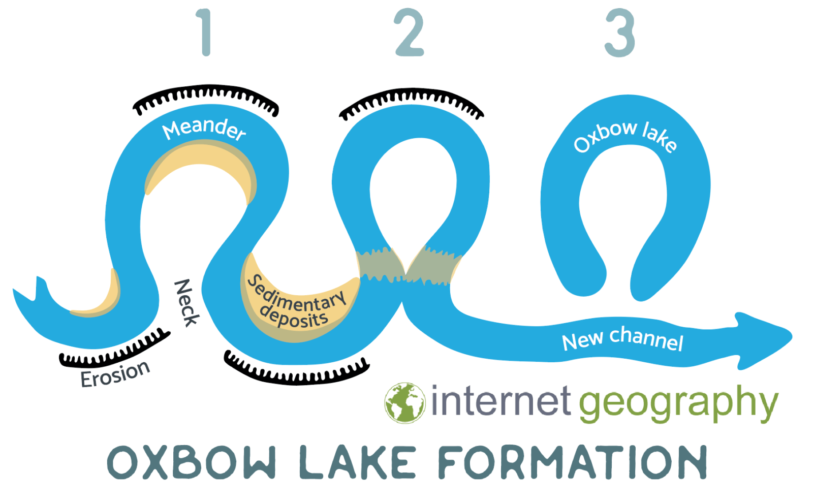
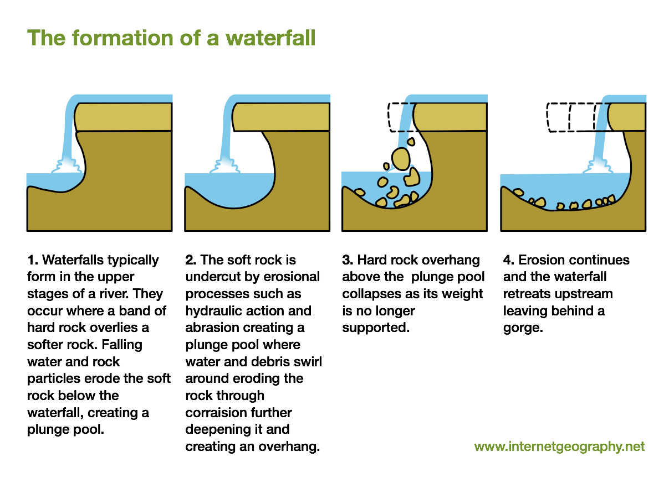
Rivers brain dump
Upper course = waterfalls/ gorges, v-shaped valley
Middle course= meanders, ox bow lakes
Lower course= estuary, flood plain
Erosion;
Abrasion (picked up and thrown)
Attrition (against each other)
Solution (dissolved)
Categorise the information and check against your notes/ knowledge organiser to see what information was left out. Add it in a different coloured pen.
Transportation;
Suspension (carried)
Traction (rolled)
Solution (dissolved)
Natural causes of flooding | Human causes of flooding
Steep slopes | Urbanisation
Heavy, prolonged rainfall | Deforestation

Slide 9
Rivers brain dump
Upper course = waterfalls/ gorges, v-shaped valley, interlocking spurs
Middle course= meanders, ox bow lakes
Lower course= estuary, flood plain, delta
Erosion;
Abrasion (picked up and thrown)
Attrition (against each other)
Solution (dissolved)
Hydraulic action (cracks)
Transportation;
Suspension (carried)
Traction (rolled)
Solution (dissolved)
- Saltation (bounced)
Natural causes of flooding | Human causes of flooding
Steep slopes | Urbanisation
Heavy, prolonged rainfall | Deforestation

Slide 10
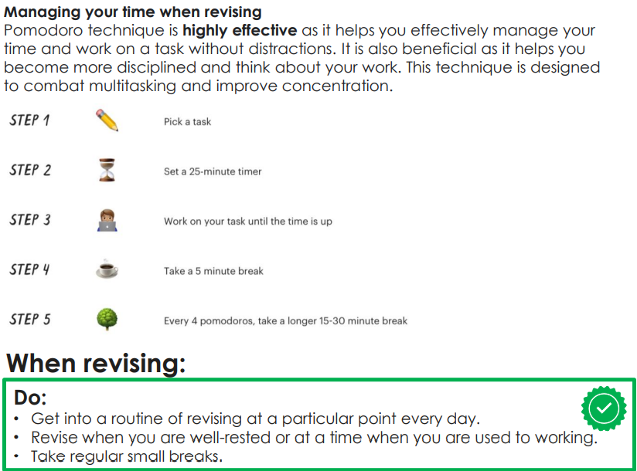


Slide 11



Slide 12

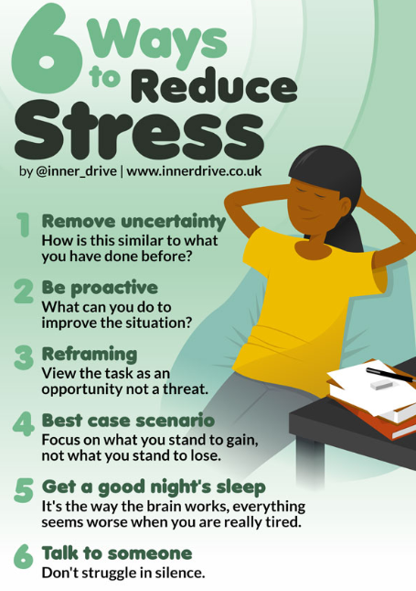

Slide 13
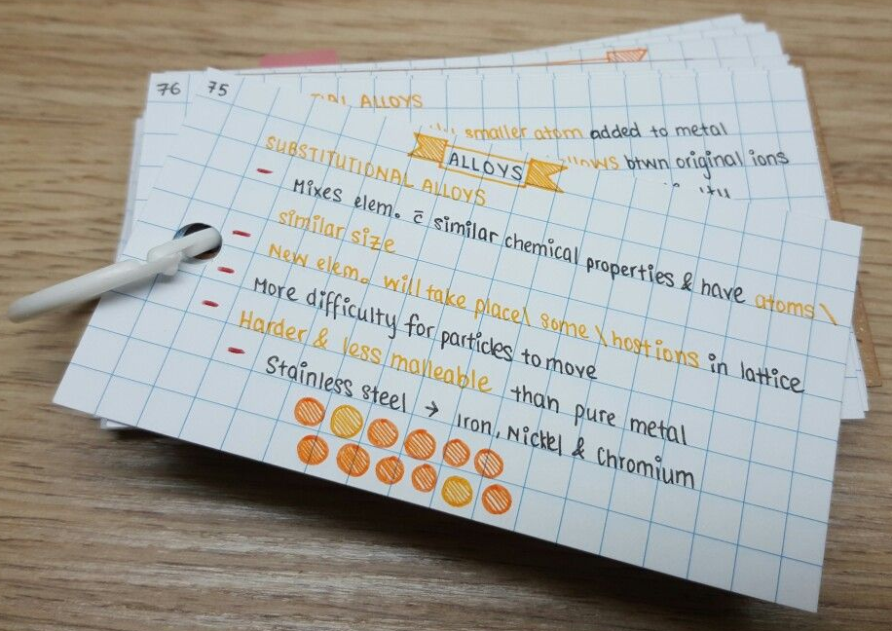

Pick a method that you would like to try and test it out today! You can try a different method tomorrow or Friday.
Flash cards
Brain dump
Self quizzing
Remember, NO HOMEWORK, NO PHONES.
Let’s get prepared for the mocks!

