Slide 1
Revision technique 1
Mind maps

Slide 2

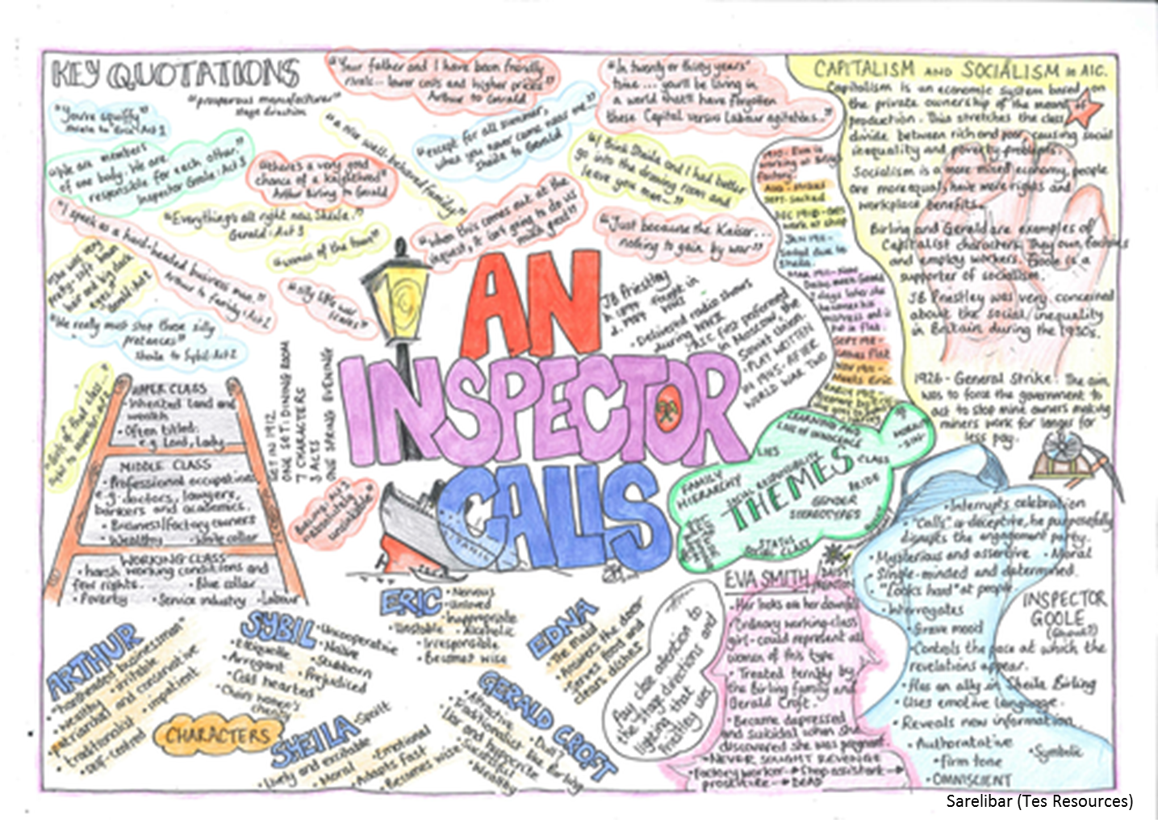
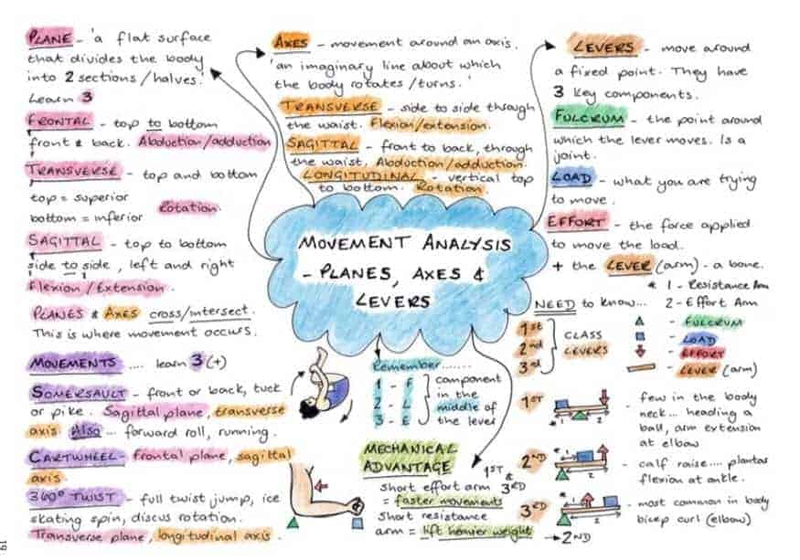
What makes an effective mind map?
Notes:
Clear title in the middle- not too broad
Sections to break the topics down on each branch
Colour to highlight key terms and facts
Dual coding (not just text)

Slide 3
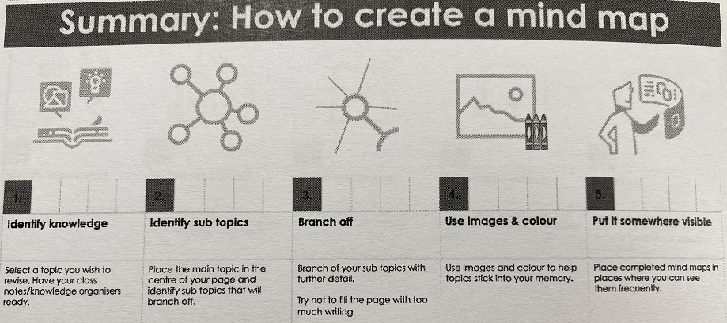

Slide 4
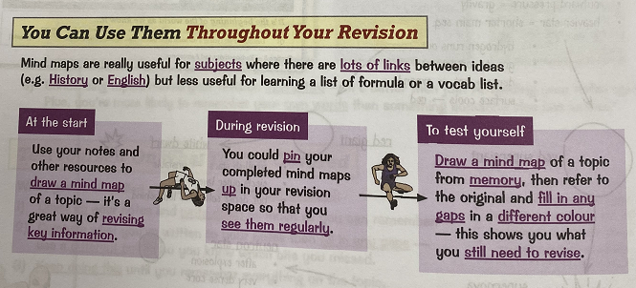

Slide 5
Geography example
We are currently looking at rivers in geography so this could be the start of a mind map.
You would have to add a sketch to each landform.
Add information about the formation of each.
Waterfalls
Interlocking spurs
Floodplains
Upper course
V-shaped valley
Lower course
River landforms
Delta
Middle course
Estuary
Meanders
Ox-bow lakes

Slide 6
Now it’s your turn!
Pick a subject and a topic and complete your own revision mind map

