Slide 1

Exam stress

Slide 2
Is it possible to avoid getting stressed before an exam?
Taking exams is a stressful time, there are a lot of things going on for you at this time:
The weight of expectation to succeed.
Am I good enough?
Have I done enough work and revision?
Will I let myself down?
Will I get into college or university?
Can you think of any other thoughts that might make you stressed?

Slide 3
Is all stress bad?
Stress is not all bad and the right amount of stress actually helps us to produce our best performance.
However, too much stress, or being stressed for too long can have a negative effect on both you and your chances of doing your best in exams.
The good news here is that “YES” there are some things we can do to help reduce stress to a healthy and positive level.

Slide 4
Get Organised
It may sound obvious, but you would be surprised how many people do not organise themselves to prepare for exams.
Firstly find out what resources are available to you.
Teacher are a great expert resource, although they may not have a great deal of time for every student. However, they will able to point you in the right direction.
There are many good revision guides out there in different formats, books, internet sites, videos and talking to others about what they find helpful.
Create revision lists for each subject so you know what to revise.

Slide 5
Revision list for geography
Human
Urban/ rural landscapes
Development
Global cities
Physical
Coasts
Rivers
Weather and climate
Climate change
Environment
Desertification
Water resources
Ecosystems
Fieldwork
6 stage enquiry (posing questions, collecting data, presenting data, analysing data, conclusion, evaluation)

Slide 6
Make a timetable
Start your revision in plenty of time.
Make a timetable that is flexible, so that it is a guide, rather than a plan that is set in stone.
When you get your exam timetable link your revision timetable to it so that you are revising your topics at the best time for you.
Don’t forget that you will also have to consider other things that are in your life, such as:
  Eating
  Sleep
  Family
  Other commitments
  RELAXING
Take all of your life into account and decide what time of day is best for you to study.
If you are on study leave split your days into sections, you could have morning, afternoon and evening. Then split these times in half, giving you six sections to your day.

Slide 7
Example of a revision TT
Mon | English | English | RS | Maths | Maths | Dinner
Tue | Swimming | Swimming | Science | Science | IT | Dinner
Wed | Geography | History | History | Spanish | relax | Dinner
Thu | Product design | Watch TV program | Art | Art | English | Dinner
Fri | Maths | Maths | Relax | Drama | Go out | Go out
Sat | Science | Science | Football | Football | Family | Family
Sun | relax | relax | Food and textiles | Food and Textiles | Relax | Relax

Slide 8
Revision TTs
When you are on study leave you can divide your timetable up in three main sections for morning, afternoon and evening, and then into smaller sections if you prefer.
After deciding on how you are going to divide your time and the length of time for each section make a list of topics you need to revise.
Remember that if you find a certain subject more difficult you may need to allocate it more time for revision, then add on a bit more time.
When you have worked out all of this divide your topics up between the units.

Slide 9
Starting your revision now for the March PPEs and the summer GCSEs
Over the next few days you need to tick off the following tasks;
Create or show your tutor your revision TT
Write a revision list for 1 of your subjects
Create a mind map for a topic for one of your subjects
  A reminder of how to do a mind map is on the following slides

Slide 10
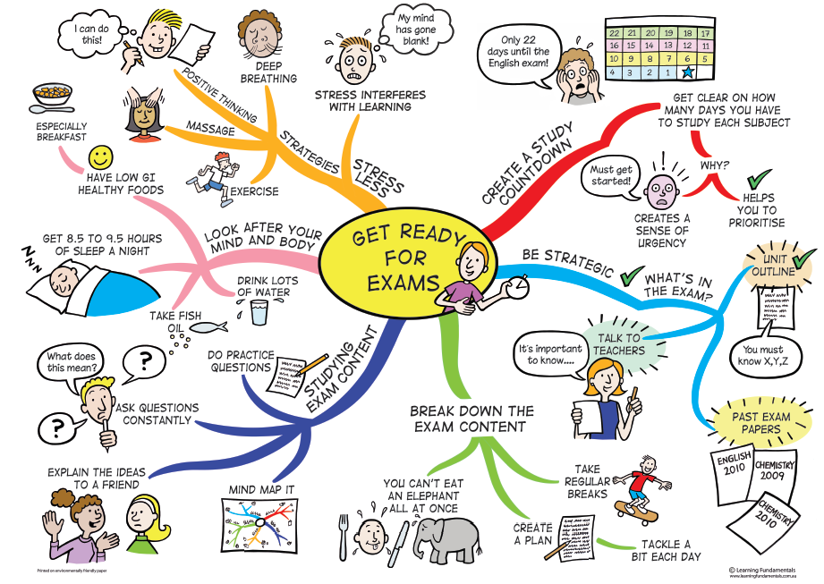
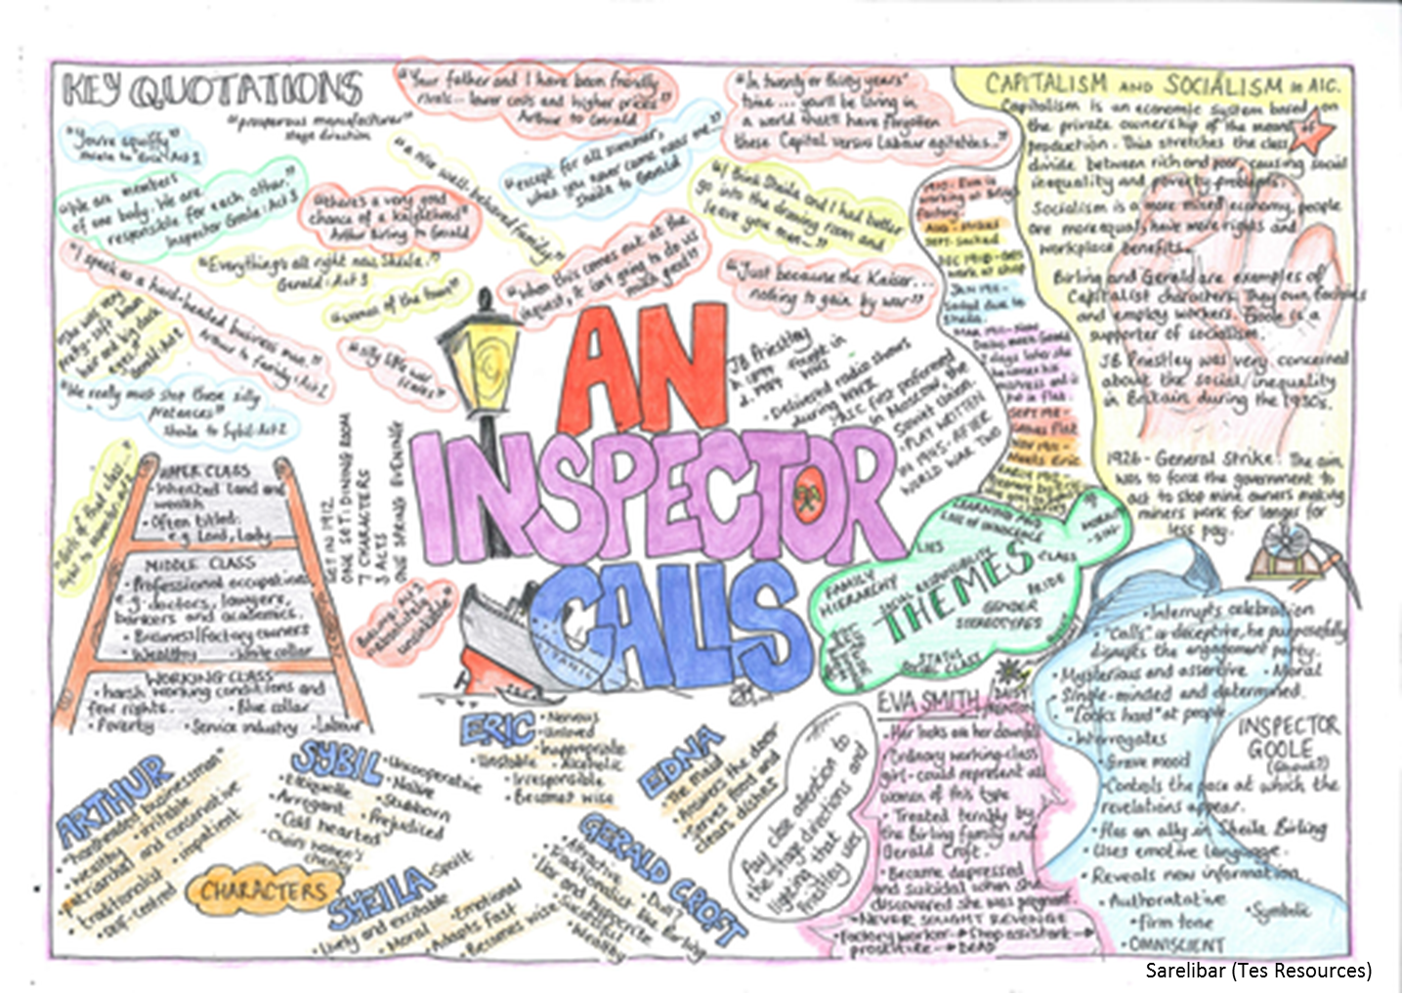
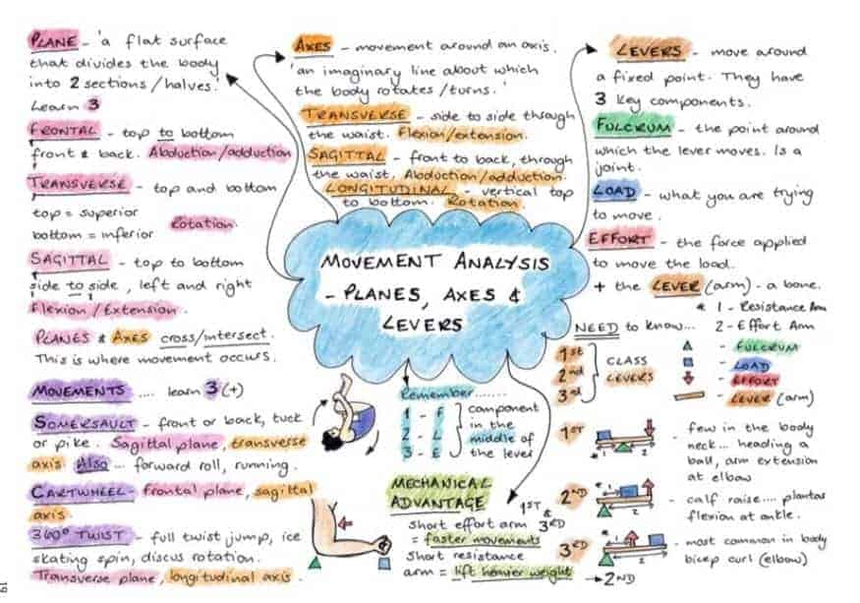
What makes an effective mind map?
Notes:
Clear title in the middle- not too broad
Sections to break the topics down on each branch
Colour to highlight key terms and facts
Dual coding (not just text)

Slide 11
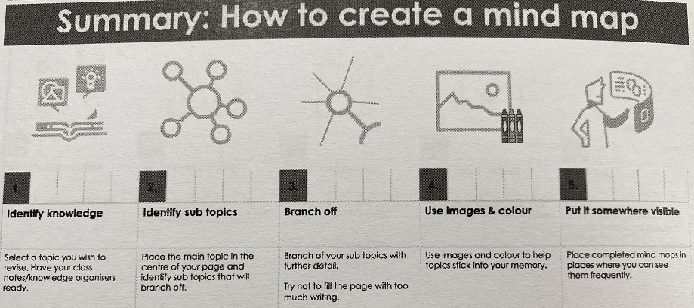

Slide 12
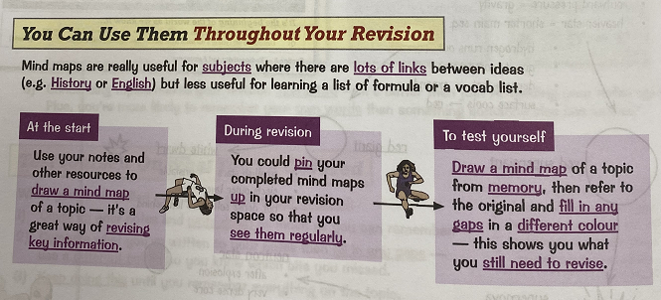

Slide 13
Geography example
This mind map links to our coasts topic.
You would have to add a sketch to each process.
Add a description to each process.
Hydraulic action
Attrition
Traction
Saltation
Erosion
Abrasion
Coastal processes
Solution
Transportation
Solution
Suspension
Longshore Drift
Deposition
When does it happen?
Which sediment is dropped first?

Slide 14
Now it’s your turn!
Pick a subject and a topic and complete your own revision mind map

