Slide 1
De-stressing
To de-stress we need to take a whole person approach. This means looking at all aspects of our lives.

Slide 2
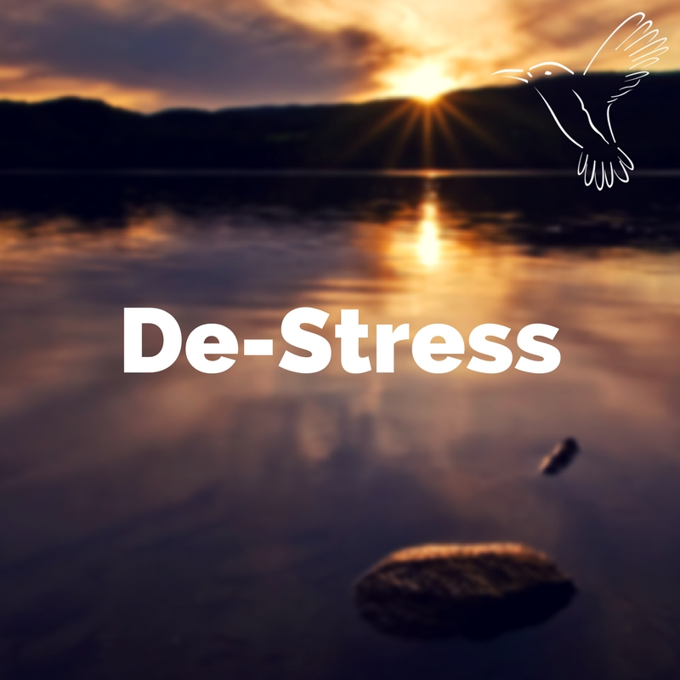
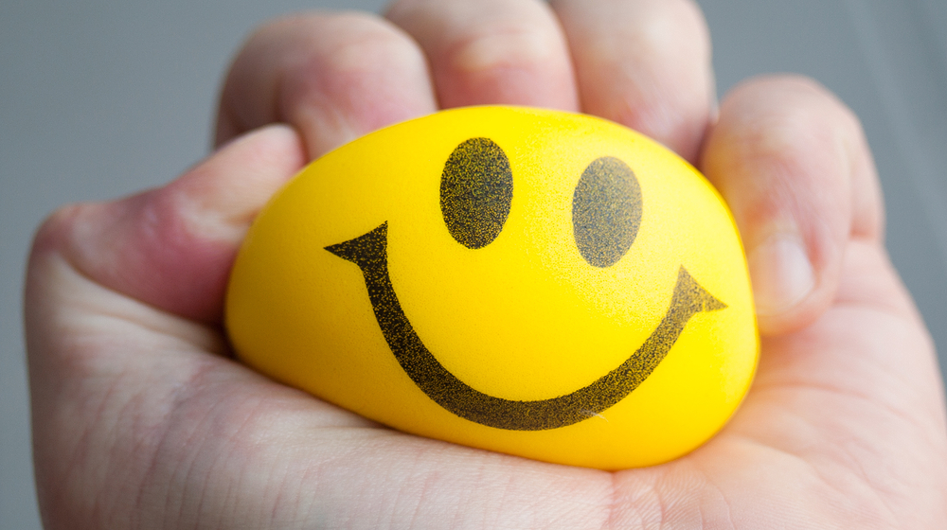
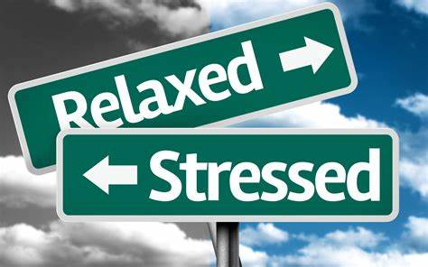
What do you do to de-stress?

Slide 3
Diet
Knowing what foods we should and shouldn’t be eating can be really confusing, especially when it feels like the advice changes regularly.
How diet can help
Eating a balanced and healthy diet is key to helping our bodies to manage the physiological changes caused by stress. An important part of any stress response includes identifying and reducing the causes of stress. Adrenal function is significantly influenced by blood sugar levels, therefore much of the dietary advice below aims to stabilise levels of sugar in the blood.
What makes up a healthy diet? Discuss

Slide 4
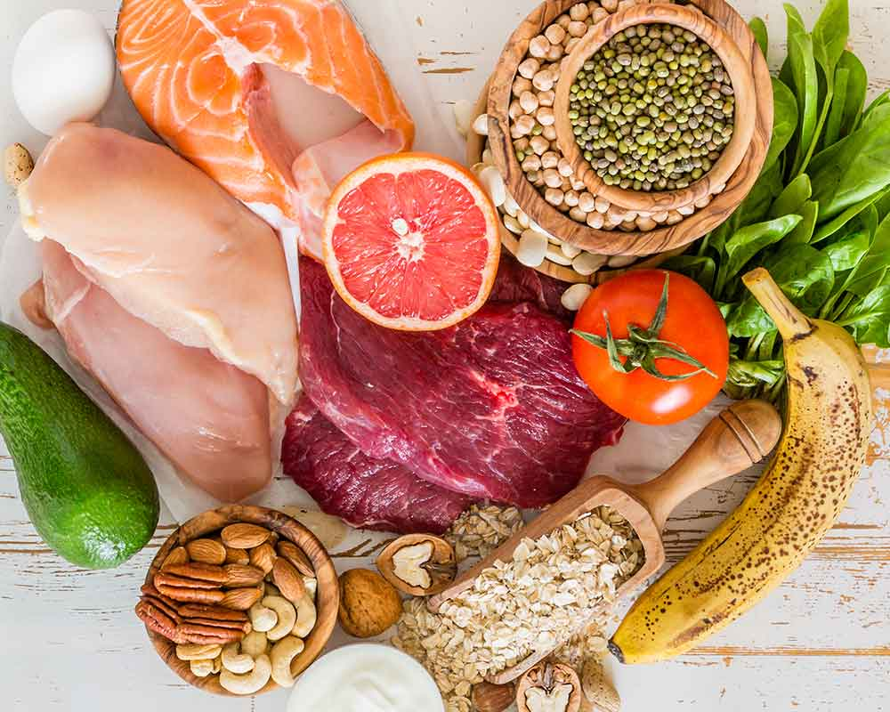
Prioritise protein
When chronically stressed the body has an increased demand for protein. Protein requirements are estimated at 0.7-1.8g per kg body weight daily. Choose lean meat, chicken, fish, eggs, beans, lentils, nuts and seeds in each meal. Protein helps to slow the release of sugar into the blood stream.

Slide 5
Try not to skip meals
Ensure that you eat regularly, taking healthy snacks as necessary. Small, regular meals will help to maintain energy levels, focus and mood, while decreasing tiredness and irritability.
What would qualify as a ‘healthy snack’?

Slide 6
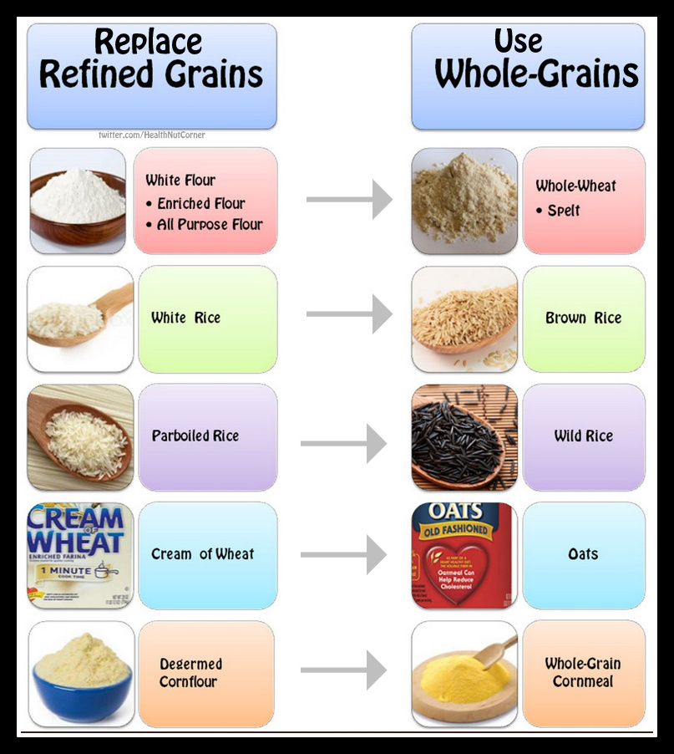
Avoid highly refined foods
Such as white bread, pasta, chocolate, biscuits, sweets or foods with added sugars. Hidden sugars are also in many cereals, breads, tinned produce and processed or packaged foods. Replace processed foods with the unrefined foods such as brown bread, rice, oats and rye.

Slide 7
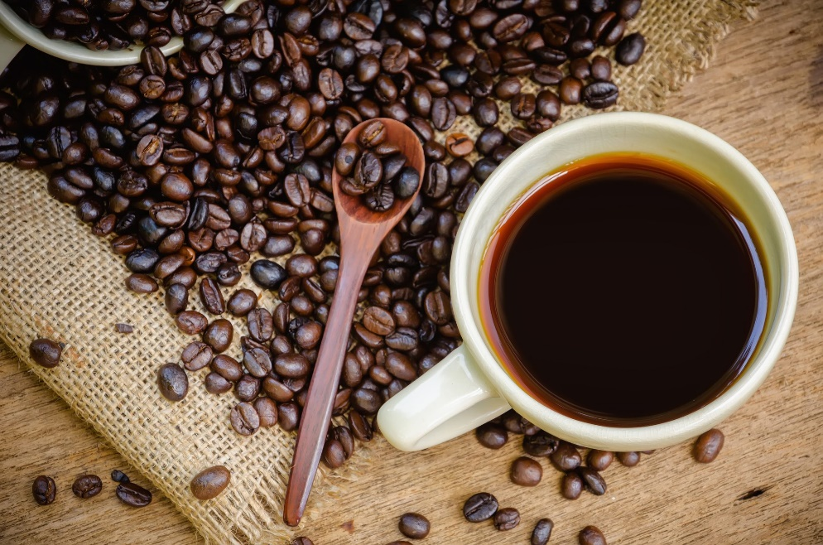
Watch the caffeine
Stimulants such as tea and coffee may provide a temporary energy boost, but consuming too much may reduce energy levels and deplete nutrients in the long term. Aim to drink at least 1-1.5 litres of water throughout the day and try herbal teas instead of caffeinated drinks.

Slide 8
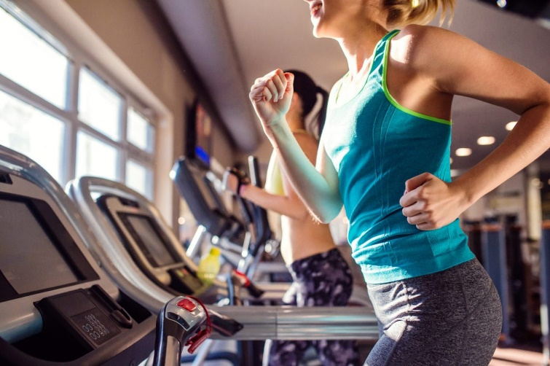
Exercise
Regular exercise is very beneficial for relieving stress and decreasing negative emotions such as worry or anxiety.
It is recommended that we do an hour of exercise a day. This doesn’t have to be all in one go, we can do it in smaller doses.
You can also fit it around your day, for example; walk instead of taking the bus or getting a lift. Take the stairs rather than the lift, walk the dog(if you have one).

Slide 9
Relaxation
Regular relaxation needs to be built into our daily life.
Reading, having a bath (Lavender bubble bath and smelly candles are great to help relaxation, just don’t fall asleep in the bath!), listening to calming music or doing some creative art is a great ways to promote relaxation.
Here are some relaxation techniques that you can try. It is usually best to do these regularly and it is better to do them in daily short sessions than in long sessions every few days.
Find a comfortable place where you can do these without being disturbed for your daily sessions, you can also use them in day to day life to keep yourself calm and in a good place.

Slide 10
Breathing techniques
Breathing techniques can be a very effective way to help with anxiety. Here are a few that you can try and find which one or ones you find most effective.
Belly Breathing
Here is a link to a video that you can follow to learn this technique.
Belly breathing trains you to slow down your breathing and take fuller, deeper breaths which help you calm down, slow your heart rate, lower blood pressure and calm both your body and mind.
https://www.youtube.com/watch?v=Wemm-i6XHr8

Slide 11
Revision focus for this week
I would like you to continue with revising using the mind map technique.

